Slide 1
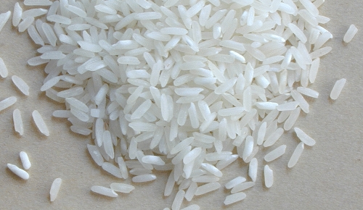

Rice Quality with Matlab Image and Vision Toolbox
Wilmer Ariza
1758306
Gurpreet Singh
1759248
Faculty of Engineering & Industrial Sciences
HIR508 Intelligent Inspection Systems
Master of Engineering in Advanced Manufacturing

Slide 2
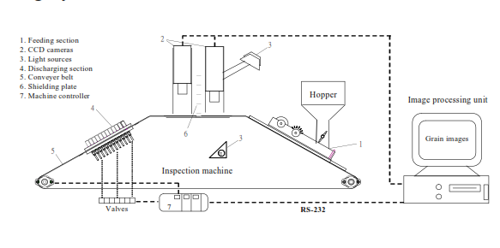
Rice Kernel
Vision system to measure GRAINS (Wan 2002)

Slide 3
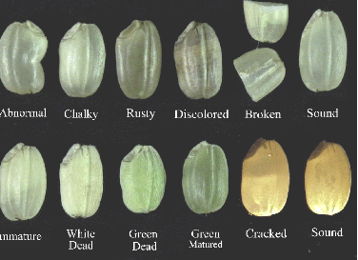
Rice Kernel
PARAMETER OF COLOR AND FORM OF WAN MODEL (WAN 2002)

Slide 4
Image and Vision Toolbox
Graythresh
Global image threshold using Otsu’s method
Syntax
Level=graythresh(I)
[level EM]=graythresh(I)
Level=graythresh(I) calculates a global threshold (level) which are used to convert an intensity image to a binary image with im2bw. Level is a normalized intensity value which falls in the range [0, 1].
In the Otsu’s method the graythresh function chooses the threshold to minimize the interclass variance of the black and pixels .

Slide 5
Image and Vision Toolbox
bwlabel
L=bwlabel (BW, n)
[L, num]=bwlabel (BW, n)
Where, L=bwlabel (BW, n) returns a matrix L, of the same size as BW and containing labels for connected objects in BW . The elements of L have integer values more than or equal to 0 and the pixels specify 0 are the background. The pixels labeled 1 form one object; the pixels labeled 2 forms second object; and so on.

Slide 6
Image and Vision Toolbox
Imfill
Imfill is used to fill image regions and holes
Syntax
BW2 = imfill(BW)
[BW2,locations] = imfill(BW)
BW2 = imfill(BW,locations)
BW2 = imfill(BW,'holes')
I2 = imfill(I)
BW2 = imfill(BW,locations,conn)

Slide 7
Frame Processing
function RiceComVision(vid,sizeKernel,Color,DiskSize)
vid1 = vision.VideoFileReader(vid);
vido=vision.VideoFileReader(vid);
hp = vision.DeployableVideoPlayer;
finfo = info(vid1);
XVid=finfo.VideoSize;
while vid1.isDone==0
[videoFrame , Original]=SubRutineIM(vid1,XVid,sizeKernel,Color,DiskSize);
step(hp, videoFrame);
StopFlag=getappdata(0,'StopFlag');
if StopFlag==1
break;
end
end
release(hp);

Slide 8
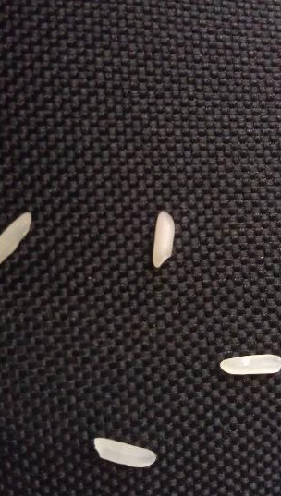
Frame Processing
Original Frame
function [f,Original]=SubRutineIM(vid,XVid,sizeKernel,Color,DiskSize)
videoFrame = step(vid);
Im=videoFrame;
Original=videoFrame;

Slide 9
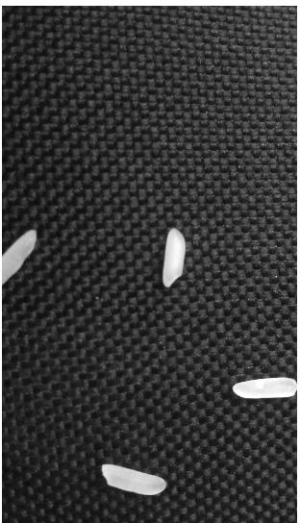
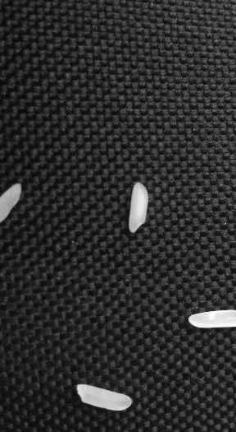
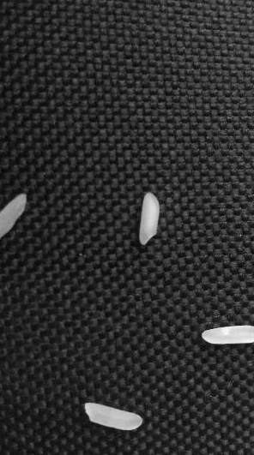
Frame Processing
3D matrix to 3-2D
Im= im2double(Im);
%imshow(Im);
[r c p]=size(Im);
imR=squeeze(Im(:,:,1));
%imshow(imR);
imG=squeeze(Im(:,:,2));
%imshow(imG);
imB=squeeze(Im(:,:,3));
%imshow(imB);

Slide 10
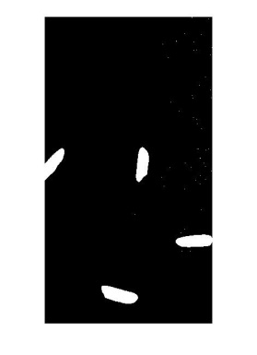
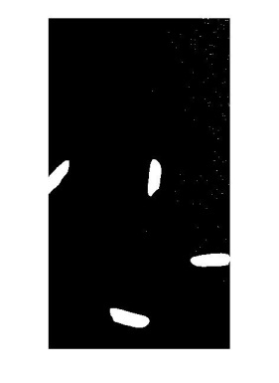

Frame Processing
Color to binary
imBinaryR=im2bw(imR,graythresh(imR));
%imshow(imBinaryR);
imBinaryG=im2bw(imG,graythresh(imG));
%imshow(imBinaryG);
imBinaryB=im2bw(imB,graythresh(imB));
%imshow(imBinaryB);

Slide 11


Frame Processing
Color to binary
imBinary=imcomplement(imBinaryR&imBinaryG&imBinaryB);
imBinary=imcomplement(imBinary);

Slide 12
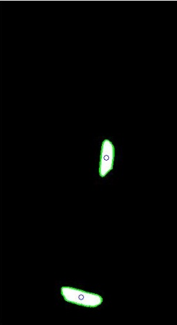
Frame Processing
imBinary=imcomplement(imBinaryR&imBinaryG&imBinaryB);
imBinary=imcomplement(imBinary);
se=strel('disk',DiskSize);
imClean=imopen(imBinary,se);
imClean=imfill(imClean,'holes');
imClean=imclearborder(imClean);

Slide 13
Frame Processing
videoFrame=cat(3,imR,imG,imB);
[labels, numLabels]=bwlabel(imClean);
for i=1:numLabels
imR(labels==i)=median(imR(labels==i));
A1=median(imR(labels==i));
imG(labels==i)=median(imG(labels==i));
A2=median(imG(labels==i));
imB(labels==i)=median(imB(labels==i));
A3=median(imB(labels==i));
AVcolor={[A1 A2 A3]};
AC(1,i)=AVcolor;
end

Slide 14
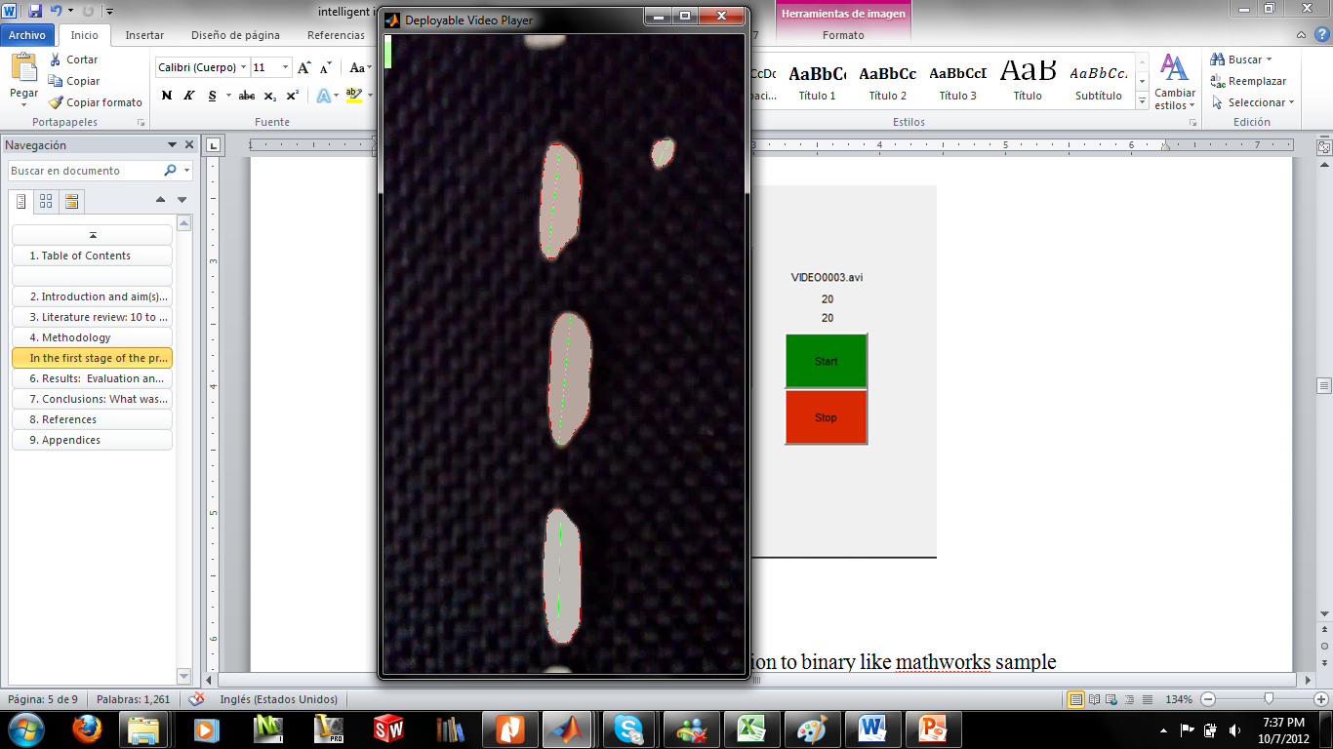
Frame Processing
[B,L,N] = bwboundaries(imClean);
dis=zeros(1,length(B));
for d=1:length(B);
boundary = B{d};
[xmax,ymax]=size(boundary);
Auxiliar=zeros(XVid(1,2),XVid(1,1));
for x=1:xmax;
videoFrame(boundary(x,1),boundary(x,2),1)=1;
videoFrame(boundary(x,1),boundary(x,2),2)=0;
videoFrame(boundary(x,1),boundary(x,2),3)=0;
end
for it=1:XVid(1,2)
for jt=1:XVid(1,1)
if Auxiliar(it,jt)==1;
MAXPoint=[jt it];
it=XVid(1,2);jt=XVid(1,1);
end
end
end
for it=XVid(1,2):-1:1
for jt=XVid(1,1):-1:1
if Auxiliar(it,jt)==1;
MinPoint=[jt it];
it=XVid(1,2);jt=XVid(1,1);
end
end
end
hshapeins = vision.ShapeInserter( ...
'Shape', 'Lines', ...
'BorderColor', 'Custom', ...
'CustomBorderColor', [0 200 0], ...
'Antialiasing', true);
dis(1,d)=sqrt((MAXPoint(1,1)-MinPoint(1,1))^2+(MAXPoint(1,2)-MinPoint(1,2))^2);
Pts = [MAXPoint(1,1) MAXPoint(1,2) MinPoint(1,1) MinPoint(1,2)];
videoFrame = step(hshapeins,videoFrame, Pts);
end

Slide 15
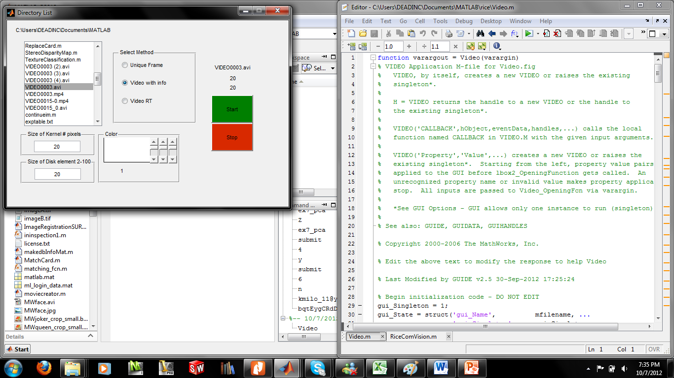
Matlab GUI
http://www.mathworks.com.au/matlabcentral/fileexchange/38391-rice-grain-quality-control

Slide 16
References
Agriculture, USDo 2009, United States Standards for Rice, viewed 05 september 2012, <http://www.gipsa.usda.gov/fgis/standards/ricestandards.pdf>.
Davies, ER 2000, Image processing for the food industry.
Kawamura, S, Natsuga, M, Takekura, K & Itoh, K 2003, 'Development of an automatic rice-quality inspection system', Computers and Electronics in Agriculture, vol. 40, no. 1-3, pp. 115-126.
Mathworks 2012a, Color-Based Segmentation with Live Image Acquisition, viewed 30 August 2012, <http://www.mathworks.com.au/videos/color-based-segmentation-with-live-image-acquisition-68771.html>.
Mathworks 2012b, Computer Vision Toolbox, viewed 21 August 2012, <http://www.mathworks.com.au/help/toolbox/vision/>.
Mathworks 2012c, Creating Graphical User Interfaces in MATLAB, viewed 8 September 2012, <http://www.mathworks.com.au/discovery/matlab-gui.html>.
Mathworks 2012d, Graytresh, viewed 4 september 2012, <http://www.mathworks.com.au/help/images/ref/graythresh.html>.
Mathworks 2012e, Image Processing Toolbox, viewed 10 October 2012, <http://www.mathworks.com.au/help/images/ref/bwlabel.html>.
Mathworks 2012f, Image processing toolbox, viewed 21 August, <http://www.mathworks.com.au/products/image/>.
Mathworks 2012g, IMfill, viewed 20 september 2012, <http://www.mathworks.com.au/help/images/ref/imfill.html>.
Verma, B 2010, 'Image processing techniques for grading and classification of rice,' Computer and Communication Technology (ICCCT), 2010 International Conference on, 220-223.
Wan, Y-N 2002, in ASIAN AGRICULTURAL INFORMATION TECHNOLOGY & MANAGEMENTChina Agricultural Scientech Press, Beijing-China.

